Slide 1

CSE 4208 : Computer Graphic Laboratory
3D Model City
Presented To:
Dr. Sk. Md. Masudul Ahsan
Professor
Md. Badiuzzaman Shuvo
Lecturer
Department of Computer Science and Engineering Khulna University of Engineering & Technology
Presented By:
Ehsanul Karim
Roll: 1907039
Department of Computer Science and Engineering Khulna University of Engineering & Technology

Slide 2
Outlines
Introduction
Objectives
Tools Used
Textures
Snapshots
Video Demonstration
Conclusion

Slide 3
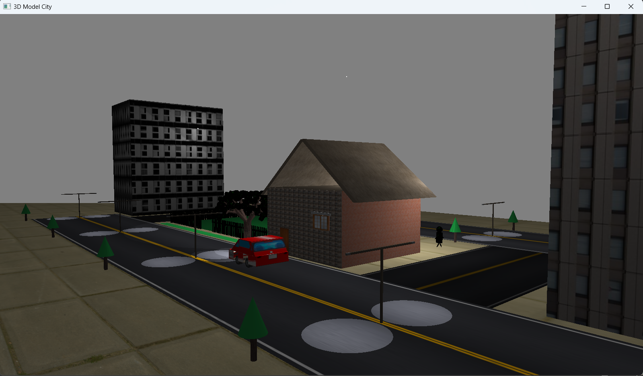
Introduction
The "3D Model City with Interactive Features" project simulates a cityscape using OpenGL, blending aesthetics and interactivity.
Figure 1:- 3D Complete View of the model city

Slide 4
Objectives
The objectives of the project are:
To build a 3D city environment in OpenGL.
To incorporate motion for objects like cars and pedestrians.
To design and implement curvy objects such as spheres, cylinders, and cones
To apply advanced OpenGL concepts like lighting, texturing, and fractals for realistic simulations.
To explore the integration of 3D models created in external tools like Blender into OpenGL.

Slide 5
Tools Used
The following tools are used to build the project
OpenGl(3.3): Rendering 2D and 3D graphics.
Glad: Glad is a straightforward and simple loader generator that manages OpenGL function pointers, enabling easy and efficient management of OpenGL
GLFW (Graphics Library Framework): Window creation and handling input (keyboard, mouse).
stb_image: For loading image.

Slide 6
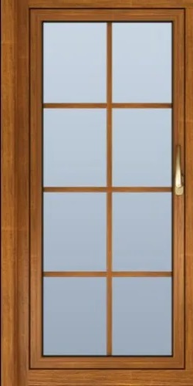
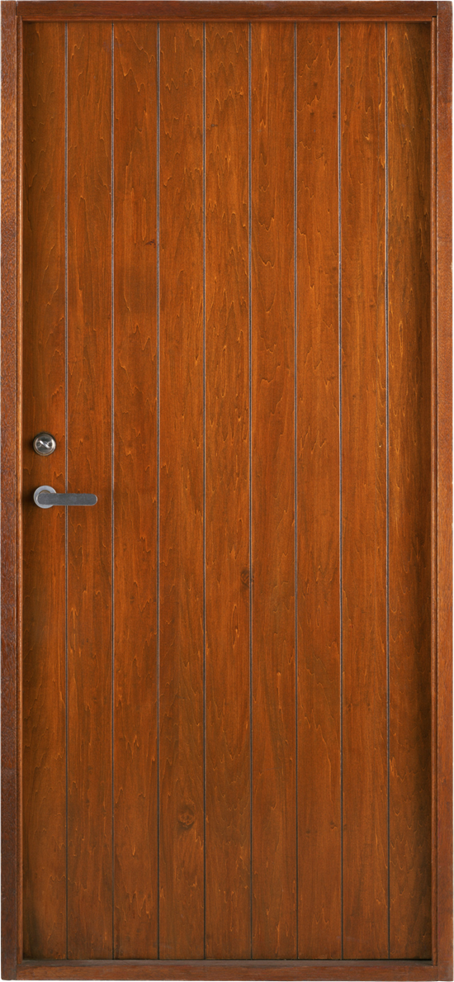
Textures
Figure 2: Window texture
Figure 3: Door texture

Slide 7
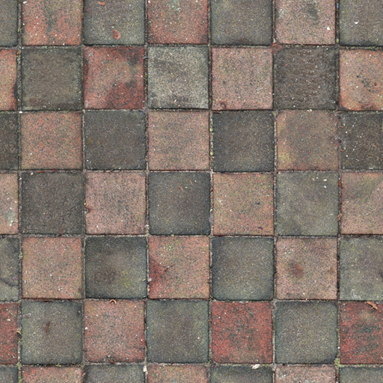
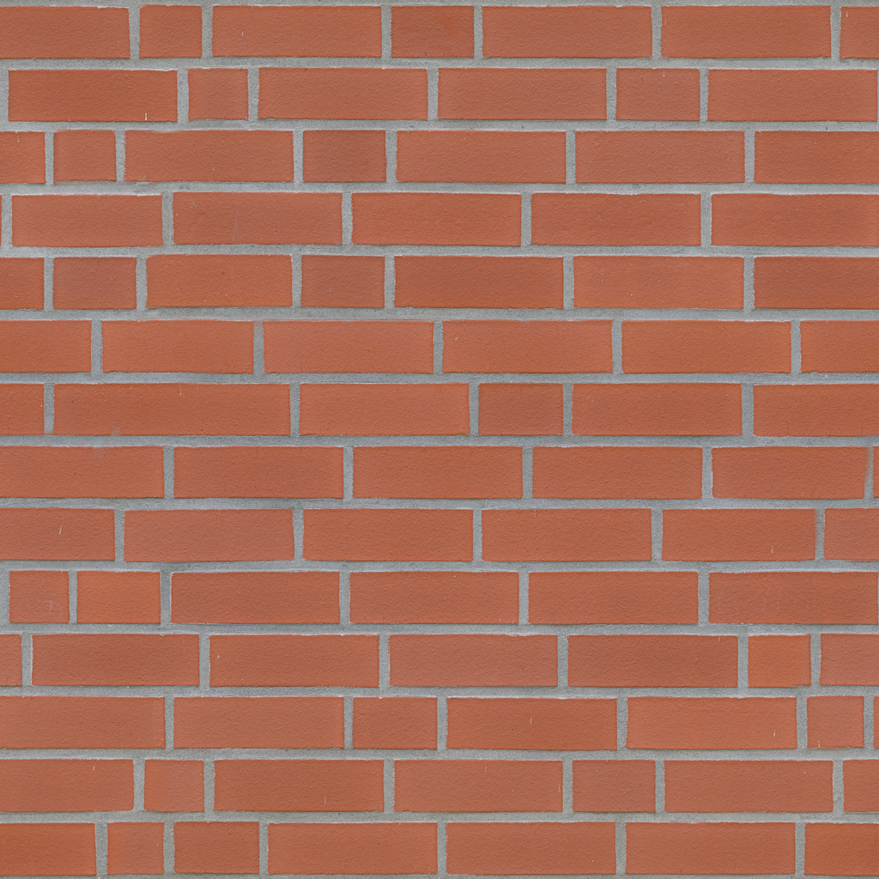
Textures (Cont.)
Figure 4: Home Front Wall
Figure 5: Brick Wall

Slide 8
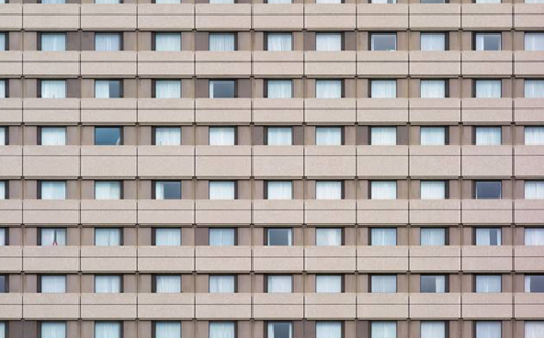
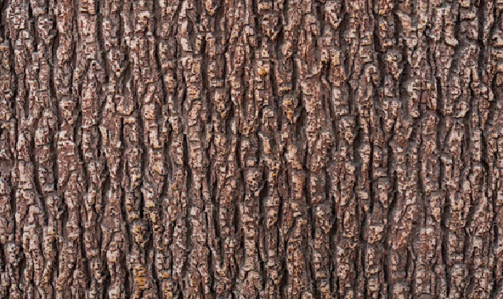
Textures (Cont.)
Figure 6: Wood texture for tree
Figure 7: Building texture

Slide 9
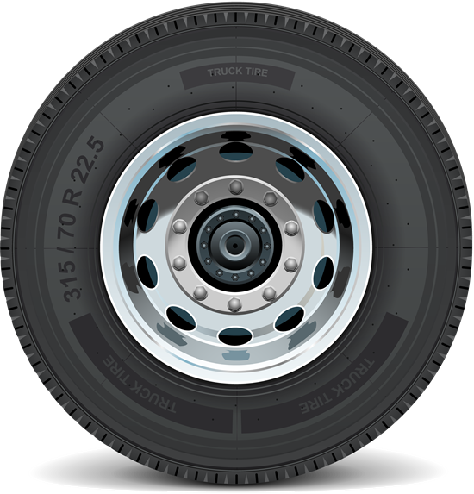
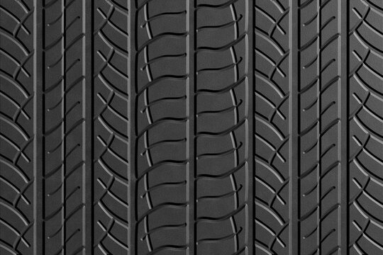
Textures (Cont.)
Figure 8: Tire Texture
Figure 9: Tire Track Texture

Slide 10
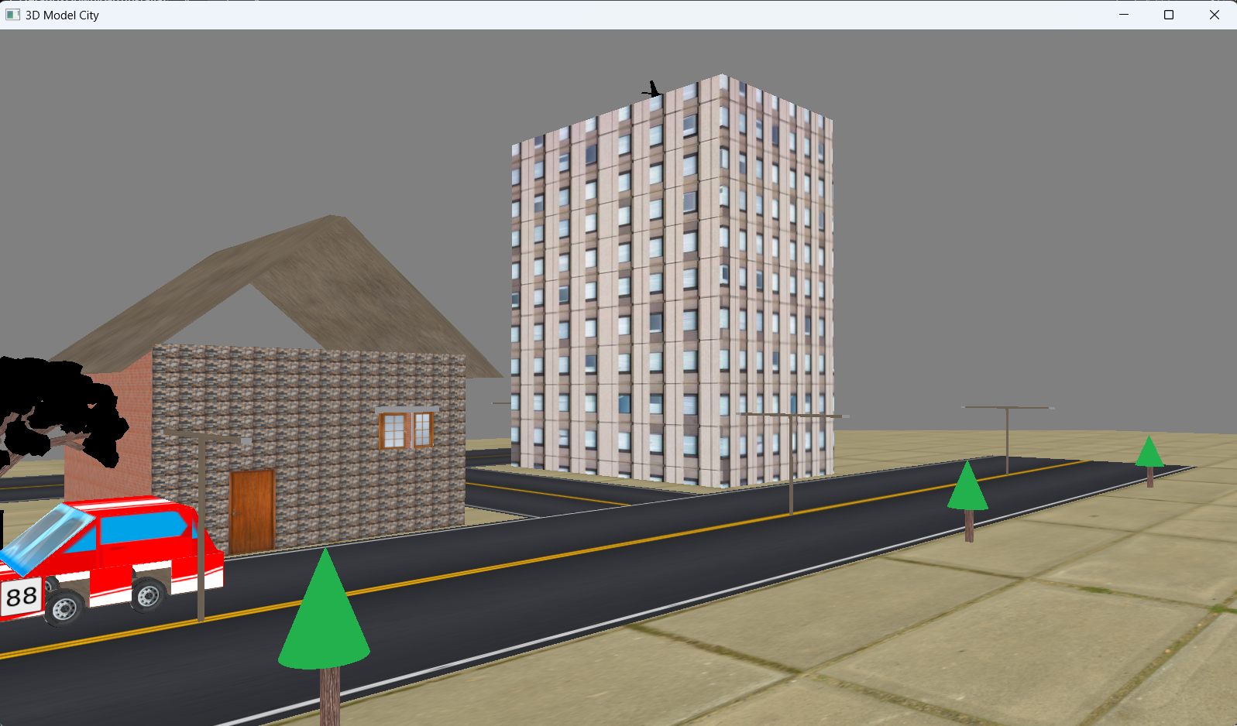
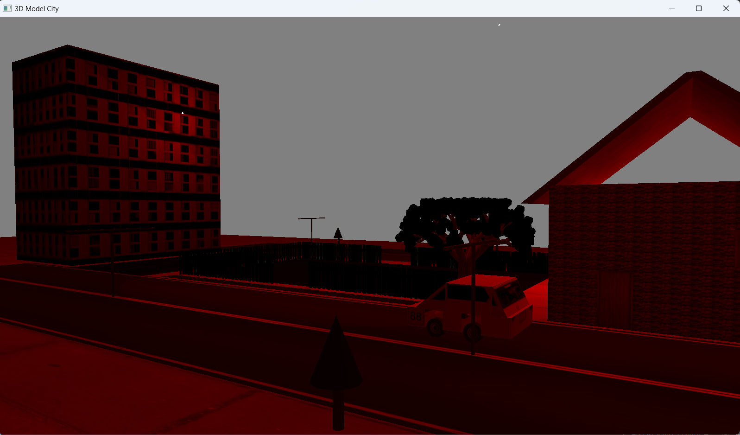
Snapshots
Figure 9: Without lightning effect
Figure 10: Blending Color

Slide 11
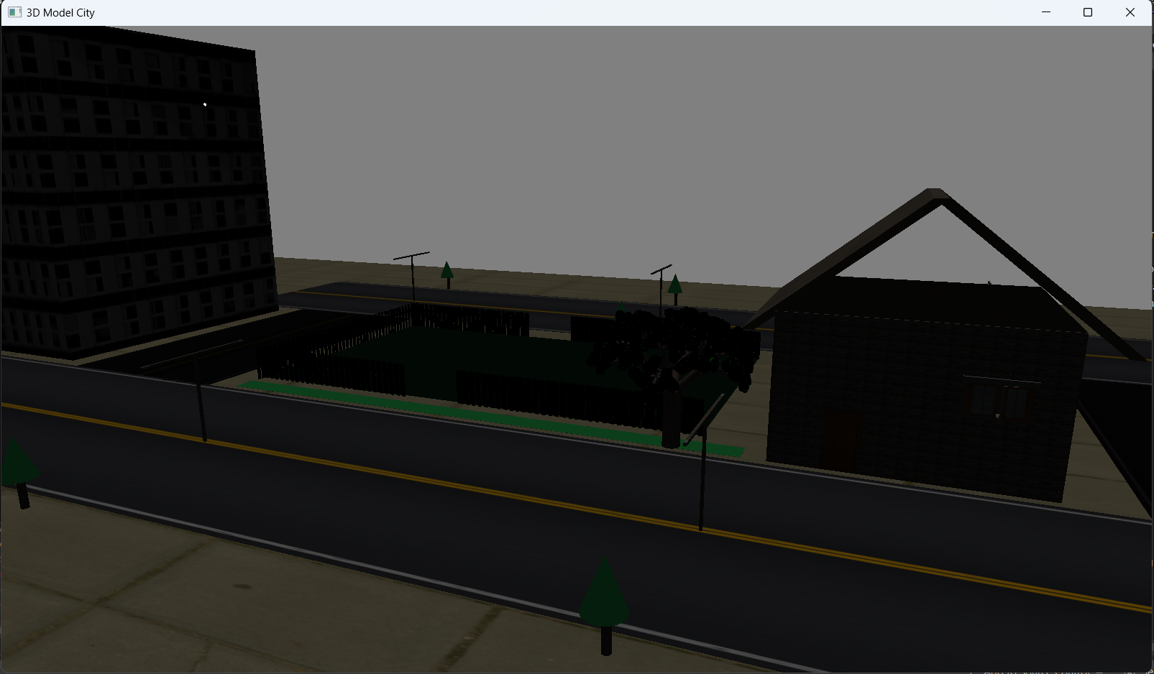
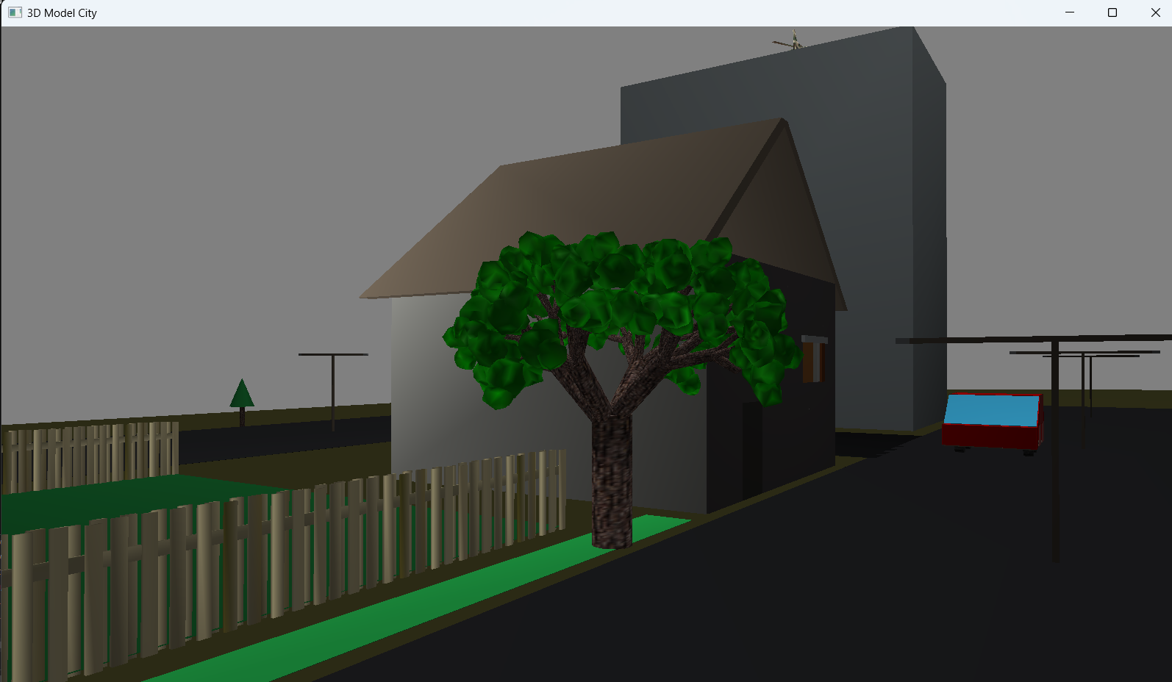
Snapshots (contd..)
Figure 11: Without Texture effect
Figure 12: Directional light only

Slide 12
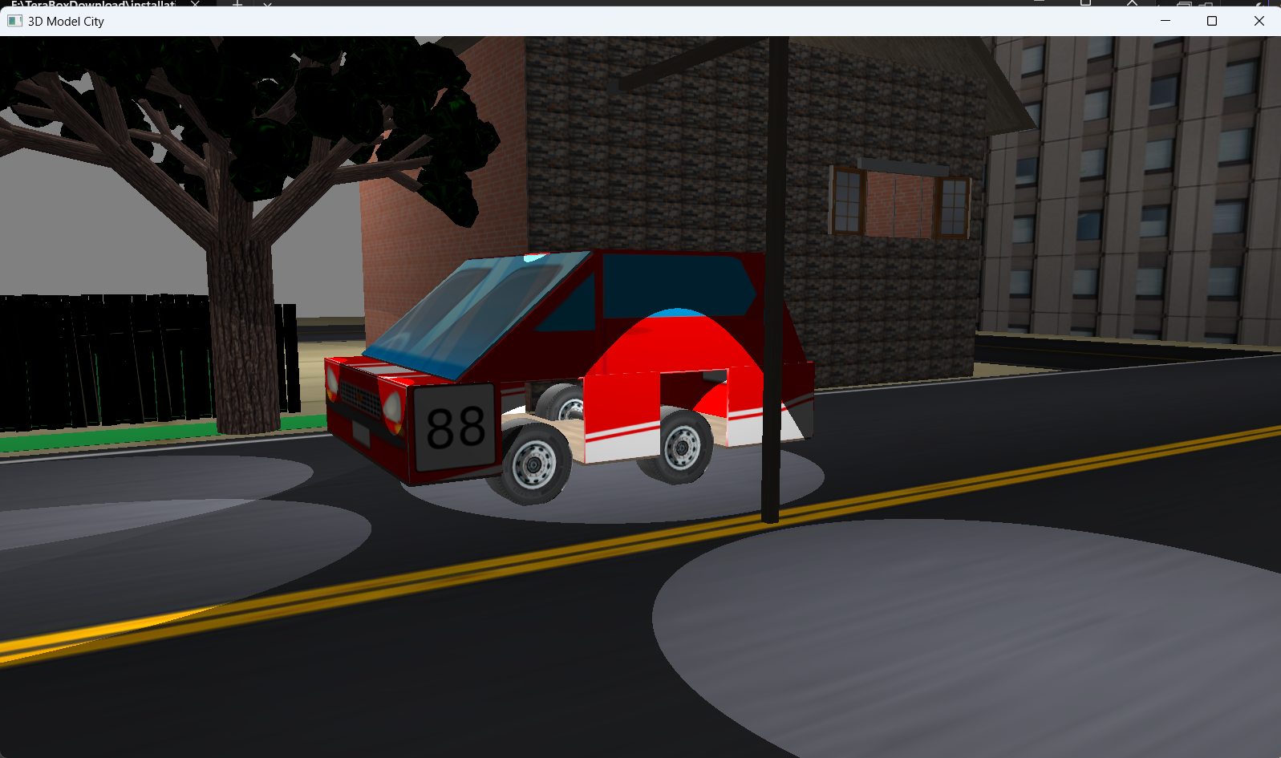
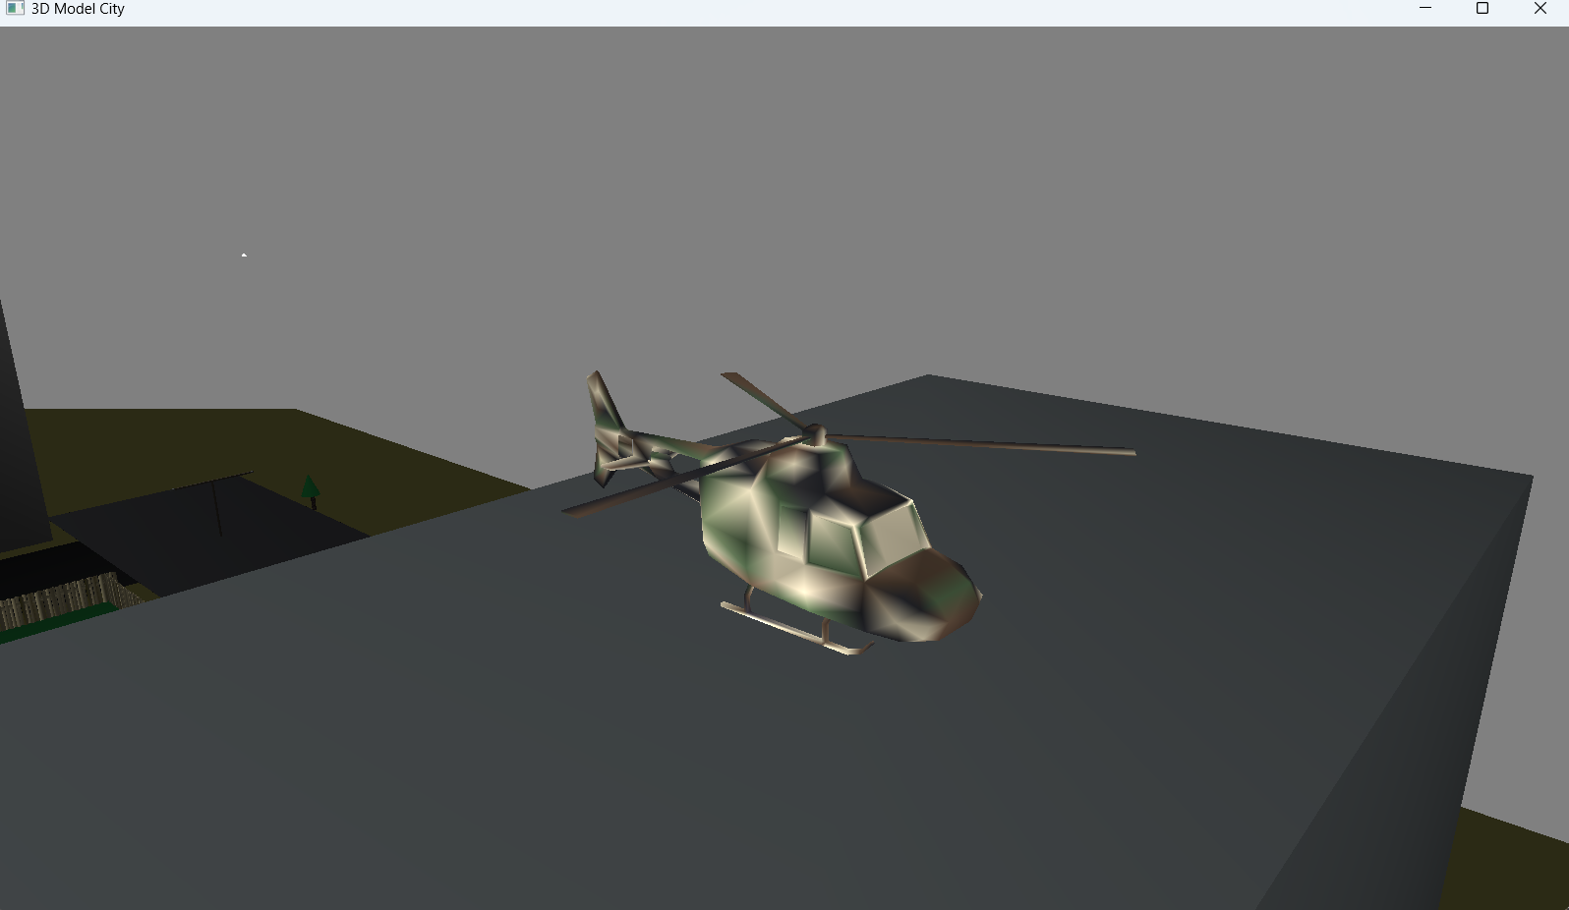
Snapshots (contd..)
Figure 13: A car with headlight
Figure 14: A 3D Blender model loaded

Slide 13
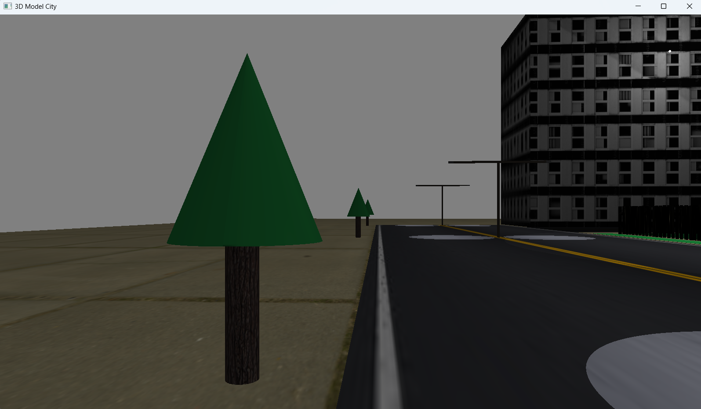
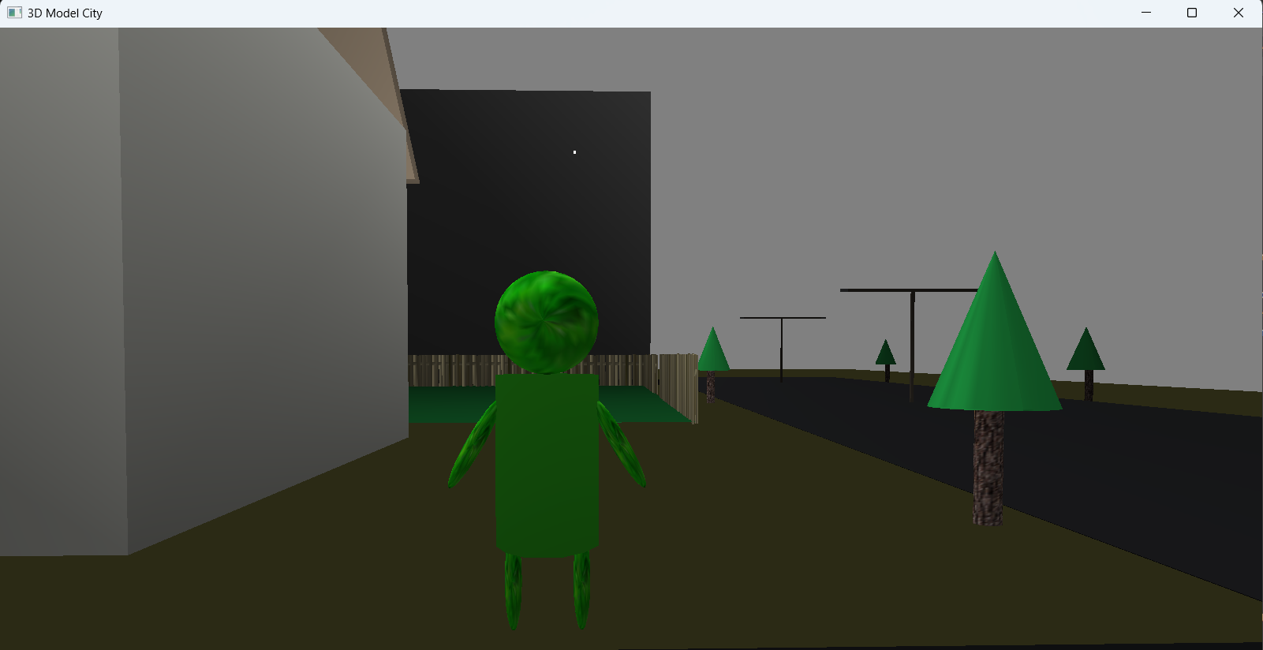
Snapshots (contd..)
Figure 15: Texture applied on Cone and Cylinder
Figure 16: A Human model

Slide 14
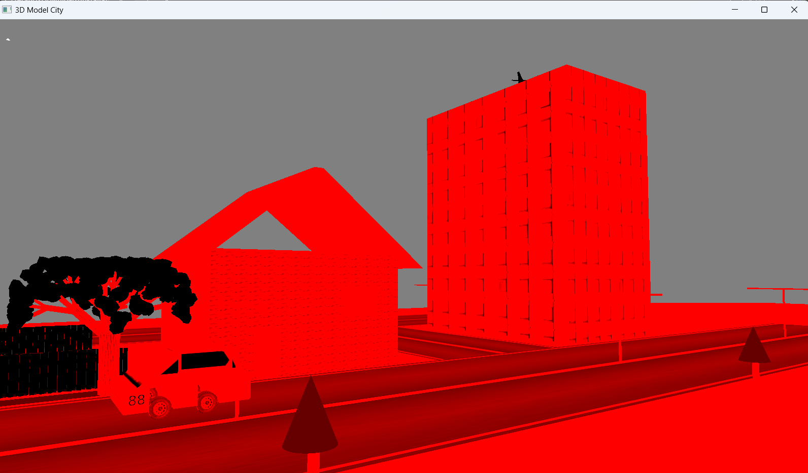
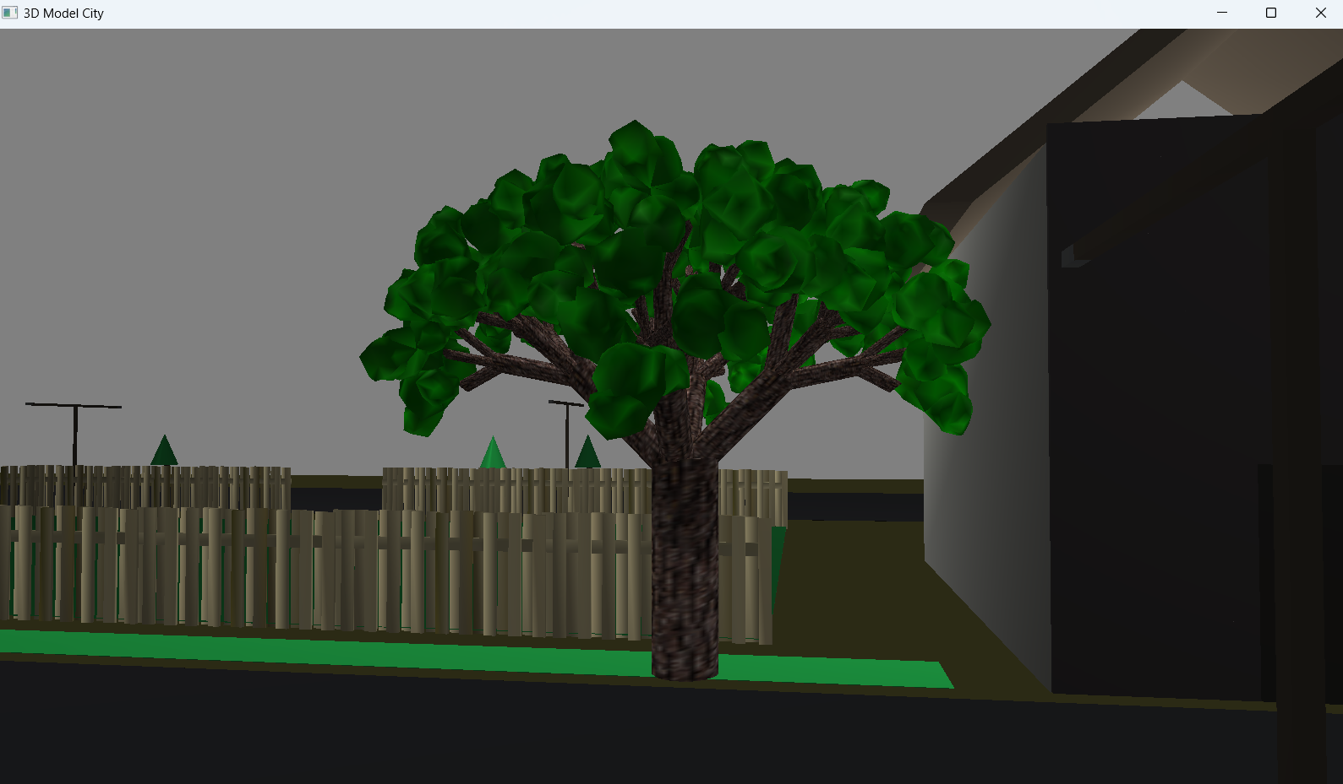
Snapshots (contd..)
Figure 17: Fractal Tree
Figure 18: Monochromatic Light

Slide 15
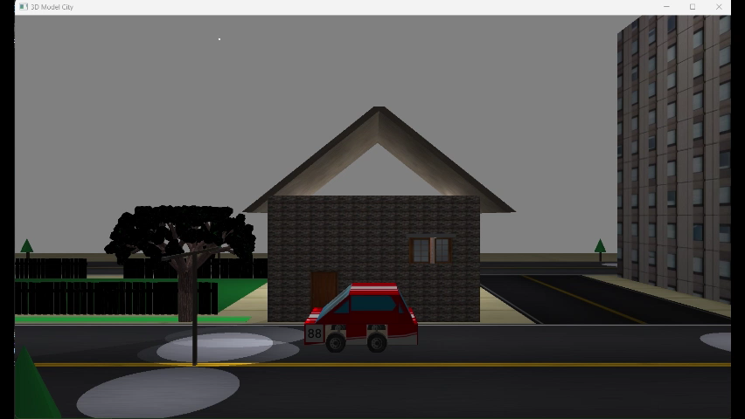
Video Demonstration

Slide 16
Conclusion
The concise conclusions of the project are:
Successful Development of 3D City Model
Application of Advanced OpenGL Concepts
Learning and Integration of External Tools.

Slide 17
Thank You

